Slide 1
Inside the CPU

Slide 2
Registers
A register is the fastest type of memory, because a register is inside the CPU
A register is not in the main memory
All arithmetic and logical operations happen inside registers
The original Intel CPU had very few registers, e.g.
AX The accumulator register
BX The base address register
CX The counting register
DX The data register
IP Points to the next instruction to be executed (along with CS)
Flags Contains results of a comparison

Slide 3
Registers: Demo
Start the emu8086 program (https://emu8086-microprocessor-emulator.en.softonic.com/download) and paste this code
org 100h
Mov ah, 30
ret
Run step-by-step
After the mov instruction is executed, we will see the AX register containing a value 30, this is because 30 in decimal = 1E in hex
Now rerun with the instruction mov ax, 65535
We will see FF in AX

Slide 4
Registers: Demo
Start the emu8086 program and paste this code
org 100h
jmp 0x7c0:0xff
ret
Run step-by-step
See how values in CS and IP registers change when the jump instruction is executed
What is the actual memory address? 0x7c0:0xff = (Segment number x 16) + Offset number = (1984 x 16) + 255 = 31,744 + 255 = 31,999
Another way to calculate is in the calculator program, select Hex and type 07C00 + FF - Result will be the same

Slide 5
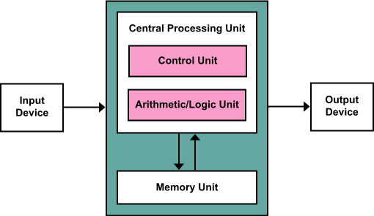
Central Processing Unit (CPU)

Slide 6
Arithmetic and Logical Unit (ALU)
The Arithmetic and Logical Unit (ALU) is where most of the action happens inside a CPU
Example: Suppose we want to add a value 5 to the accumulator register AX, then the CPU:
Copies the value from AX into the ALU
Sends the value five to the ALU,
Instructs the ALU to add these two values together,
Moves the result back into the AX register.

Slide 7
The Control Unit
The Control Unit (CU) fetches instruction codes (or op codes) from the memory and moves them into the instruction decoding register (also called as Instruction Register (IR))
The control unit contains a special register, the Instruction Pointer (IP) or Program Counter (PC) that contains the address of the next executable instruction
The control unit fetches this instruction's code from memory and places it in the decoding register for execution
After executing the instruction, the control unit increments the instruction pointer and fetches the next instruction from memory for execution, and so on

Slide 8
Structure of an Instruction
How does a CPU perform its operations?
For this, the CPU is assigned a fixed set of instructions or operations to work on
This set of commands is the CPU’s instructions set
Different CPU families (e.g. Intel, ARM) will have different instruction sets, but CPUs in the same family (e.g. Intel) will have the same instruction sets

Slide 9
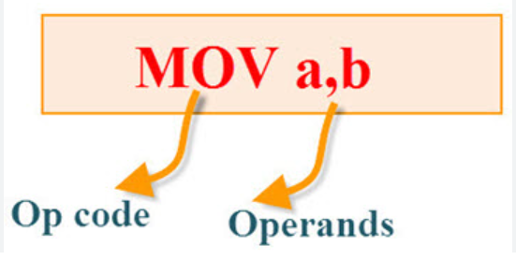
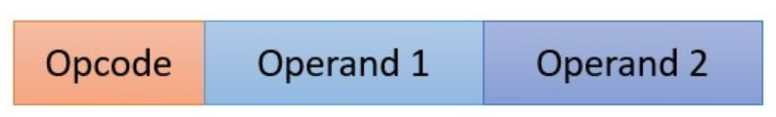
Op Code and Operands
An instruction (also called as mnemonic) is made up of two parts:
Op code: Specifies the operation/instruction to be performed
Operand: The data/value or the memory location on which the op code is going to work
Example: Add R1, R2
Add is the op code
R1 and R2 are the operands
R2 is source, R1 is destination
R2 will remain unchanged, R1 may get modified (if R2 is not 0)

Slide 10
Instruction Examples
mov reg, reg/memory/constant
mov memory, reg
add reg, reg/memory/constant
sub reg, reg/memory/constant
cmp reg, reg/memory/constant
and reg, reg/memory/constant
or reg, reg/memory/constant
not reg/memory

Slide 11
Addressing Modes
An addressing mode decides how to identify the operands
Main addressing modes: Register, Immediate, Indirect, Indexed, Direct

Slide 12
Register Addressing Mode
Here, the operands for the instruction are in the CPU registers
Hence, to execute the instruction, the CPU just needs to access the registers for accessing data, and nothing else
Example: mov ax, bx … Copy value of the bx register into the ax register
Fastest
But we have limited registers

Slide 13
Immediate Addressing
The value of the operand is explicitly mentioned in the instruction as a constant
Example: add ax, 25 … Add 25 to register ax
No memory access needed
Value size can be limited

Slide 14
Direct Addressing Mode
The instruction contains the address of the location in memory where the value of the operand is stored.
Example: mov ax, [1000] … Load the value in memory location 1000 into register ax
Simplest
Limited by register and memory size

Slide 15
Indirect Addressing Mode
The instruction contains the register that contains address of the location in memory where the value of the operand is stored.
Example: mov ax, [bx] … Get the value stored in register bx – it contains the address of the memory location from which we need to get the value and copy it into register ax
Complex
Slow

Slide 16
Indexed Addressing Mode
The instruction contains the register that contains address of the location in memory where the value of the operand is stored.
Example: mov ax, [1000+bx] … Add the contents of bx with 1000 to produce the address of the memory value to fetch
Useful for arrays, pointers, records, and other data structures

Slide 17
Impact of Addressing Modes
Advantage: Allows more flexibility to the programmer, since the operands can be in the registers, memory, or in a memory location pointed to by another memory location
Drawback: More complexity in instructions
So, we have two choices:
Allow all the addressing modes (more flexibility, more complexity)
Allow only one-two addressing modes (less flexibility, more simplicity)

Slide 18
Demo: Binary Addition
In the emu8086 program, type this code:
org 100h
mov ax, 3333
mov bx, 1111
add ax, bx
ret
First set two integer values in two registers
Then add the value in the first register to the value of the second register

Slide 19



Demo: Reading From Memory
In the emu8086 program, type this code:
org 100h
mov ax, [0x00]
ret
Run a single step
Before the move instruction is executed, note down the contents of memory location 00 and that of ax
Now execute the move instruction and recheck ax
Retry by changing to: mov ah, [0x00] and mov al, [0x00]

Slide 20
Fetch-Decode-Execute Cycle

Slide 21
Instruction Execution Step-by-Step
The x86 CPUs do not complete execution of an instruction in a single clock cycle
The CPU executes several steps for each instruction
For example, the CU issues the following commands to execute the mov reg, reg/memory/constant instruction:
Fetch the instruction byte from memory (one clock cycle)
Update the ip register to point at the next byte (one clock cycle)
Decode the instruction to see what it does (one clock cycle)
If required, fetch a 16-bit instruction operand from memory (0 or more clock cycles)
If required, update ip to point beyond the operand (0 or 1 clock cycle)
Compute the address of the operand, if required (i.e., bx+xxxx) (0-2 clock cycles)
Fetch the operand (one clock cycle)
Store the fetched value into the destination register (Execute) (1-3 clock cycles)

Slide 22
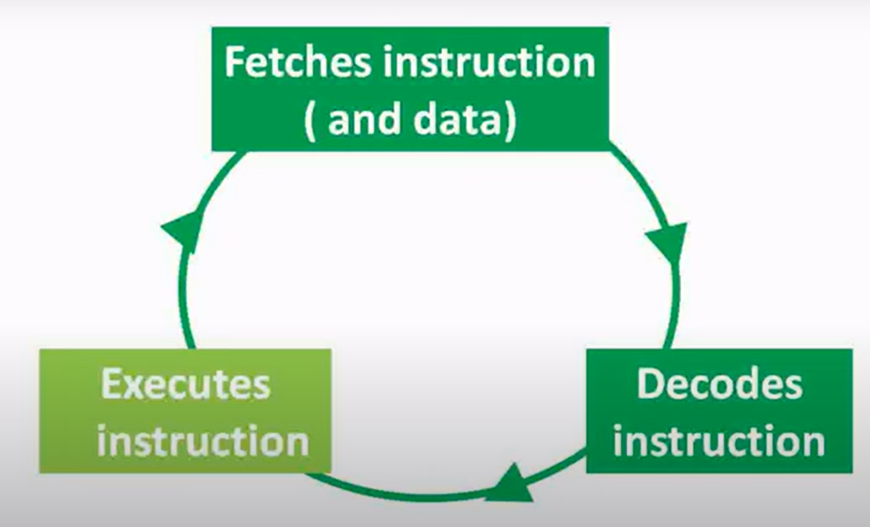
CPU Actions: Fetch-Decode-Execute

Slide 23
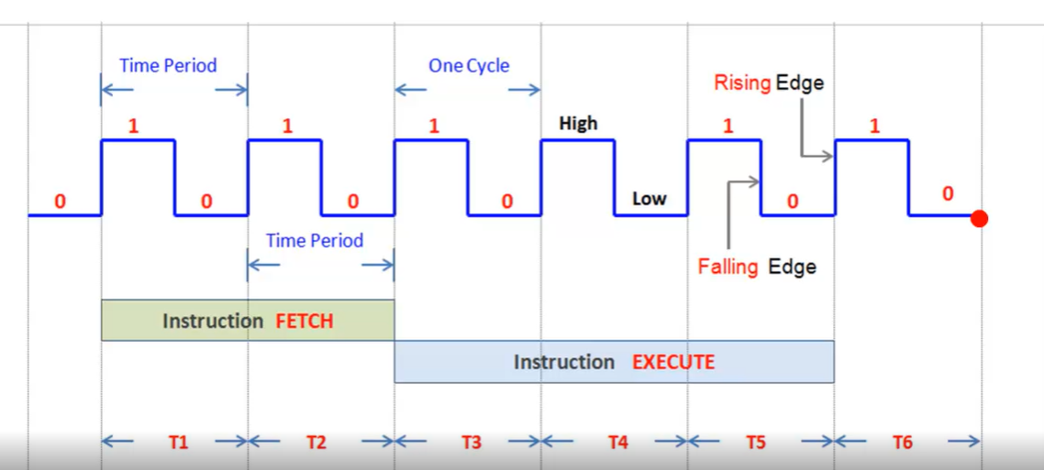
CPU Cycles and Instructions – Just an Example

